Slide 1
Stochastic Analysis of Observational and Reanalysis Precipitation Using a VARX Model
Sheryar Choudhry
CLIM 680 Class Project

Slide 2
CLIM 680 Class Project
Contents
1.
Introduction
2.
Preparing the Data
3.
Vector Autoregessive Model with Exogeneous Variables (VARX)
4.
Applying VARX Model Fits to Datasets
5.
Stochastic Analysis

Slide 3
Introduction:
Goal :
I want to compare an observational dataset and a reanalysis product to see if originate from similar stochastic processes.
More specifically, I would like to fit each grid point to a vector autoregressive model with exogenous variables (VARX).
Then using the model fits at each grid point, I can use a likelihood ratio statistic to see if my two datasets are generated from similar statistical processes.
Hypothesis:
I believe that the VARX analysis will show that the reanalysis and observational dataset stem from different statistical processes.

Slide 4
Introduction:
Datasets:
1. ECMWF ERA5 monthly averaged data on single levels from 1940 to present
https://cds.climate.copernicus.eu/datasets/reanalysis-era5-single-levels-monthly-means?tab=overview
Variables: Mean Monthly Precipitation Rate [m/day]
Spatial Resolution: 0.5° x 0.5° [721 x 1440]
Spatial extent: Global
Temporal frequency: Monthly
Temporal extent: 1940 to Present
2. The Global Precipitation Climatology Project (GPCP) Monthly Analysis Product
https://psl.noaa.gov/data/gridded/data.gpcp.html
Variables: Mean Monthly Precipitation Rate [mm/day]
Spatial Resolution: 2.5 degree latitude x 2.5 degree longitude global grid [72 x 144]
Spatial extent: Global
Temporal frequency: Monthly
Temporal extent: 1979 to Present
Citations:
Hersbach, H., Bell, B., Berrisford, P., Biavati, G., Horányi, A., Muñoz Sabater, J., Nicolas, J., Peubey, C., Radu, R., Rozum, I., Schepers, D., Simmons, A., Soci, C., Dee, D., Thépaut, J-N. (2023): ERA5 monthly averaged data on single levels from 1940 to present. Copernicus Climate Change Service (C3S) Climate Data Store (CDS), DOI: 10.24381/cds.f17050d7Links to an external site. (Accessed on 10-09-2025)
Adler, R.F., G.J. Huffman, A. Chang, R. Ferraro, P. Xie, J. Janowiak, B. Rudolf, U. Schneider, S. Curtis, D. Bolvin, A. Gruber, J. Susskind, and P. Arkin, 2003: The Version 2 Global Precipitation Climatology Project (GPCP) Monthly Precipitation Analysis (1979-Present). J. Hydrometeor., 4,1147-1167. (Accessed on 10-09-2025)

Slide 5
Preparing the Data:
Made sure both datasets cover the same time range
Convert the units for each dataset to be total accumulated monthly precipitation in mm
ERA5 was much higher resolution, so I made the dataset coarser to match GPCP

Slide 6
Vector Autoregressive Model with Exogenous Variables (VARX):
Constant: Base state/ y-intercept
Y_t-1: The previous timestep of our time series.
Annual Cycles: seasonal/annual behavior of our time series
External Forcing: Trends caused by greenhouse gases, volcanic activity, forest fires, etc.
Noise: Contains the residuals/errors the model was not able to fit

Slide 7
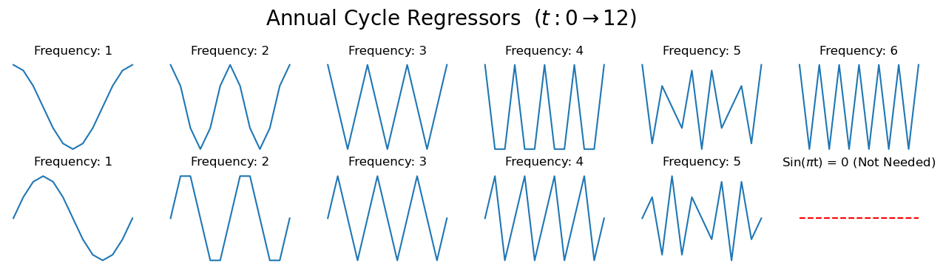
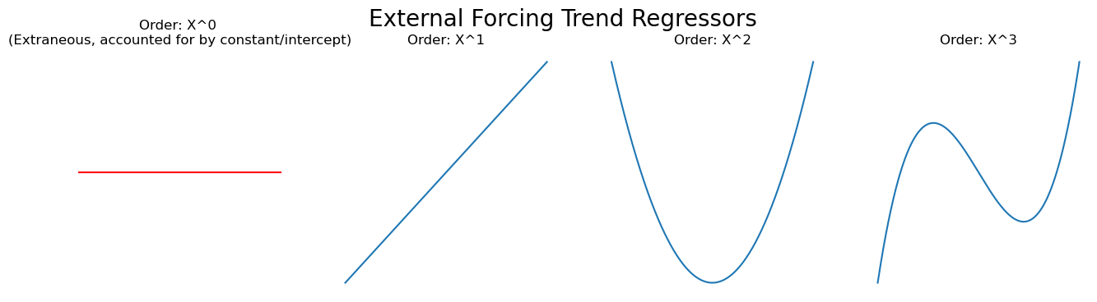
Vector Autoregressive Model with Exogenous Variables (VARX):

Slide 8
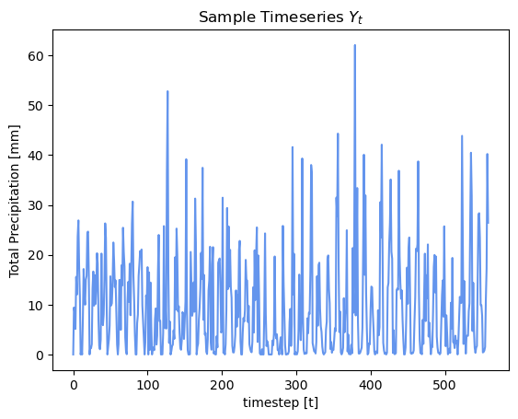
Vector Autoregressive Model with Exogenous Variables (VARX):

Slide 9

Vector Autoregressive Model with Exogenous Variables (VARX):
16 Total Regressors
Create a Z matrix containing all the regressors that can be fed into the Ordinary Least Squares Solver
Note, we skip the first value for Yt and omit the end values of our Z matrix

Slide 10
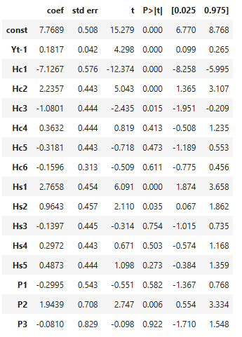
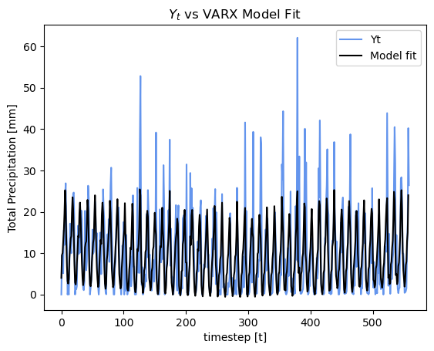
Vector Autoregressive Model with Exogenous Variables (VARX):

Slide 11
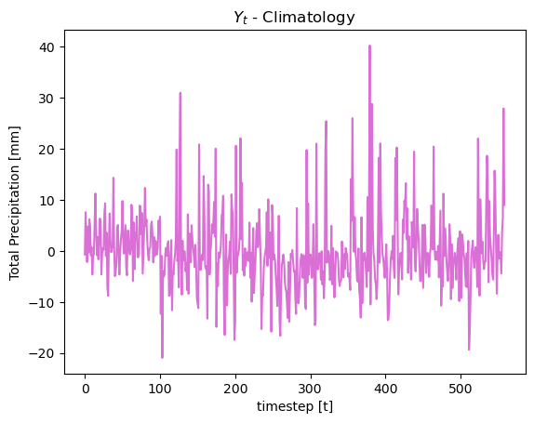
Vector Autoregressive Model with Exogenous Variables (VARX):
Potential Question?:
What if we remove the climatology from our time series. Will the VARX model still fit annual cycle coefficients?

Slide 12
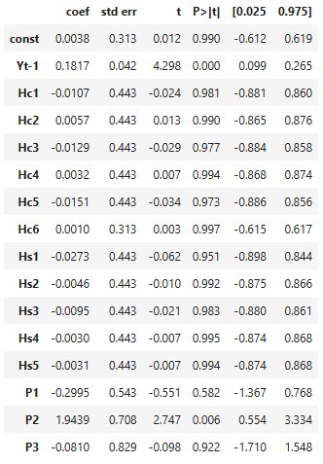
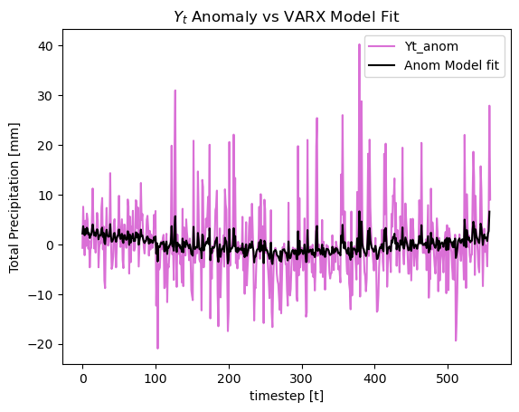
Vector Autoregressive Model with Exogenous Variables (VARX):

Slide 13
Vector Autoregressive Model with Exogenous Variables (VARX):
Procedure:
Extract the time series for each grid point
Define a Z matrix with all the regressors
Create and run the OLS fit and store the results in a separate matrix

Slide 14
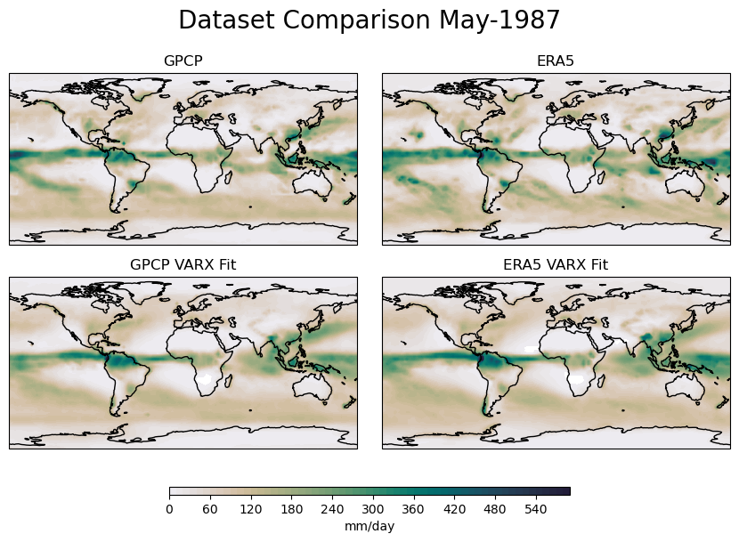
Vector Autoregressive Model with Exogenous Variables (VARX):

Slide 15




Stochastic Analysis:
Maximized Log-likelihood Ratio Test

Slide 16

Stochastic Analysis:
Maximized Log-likelihood Ratio Test

Slide 17
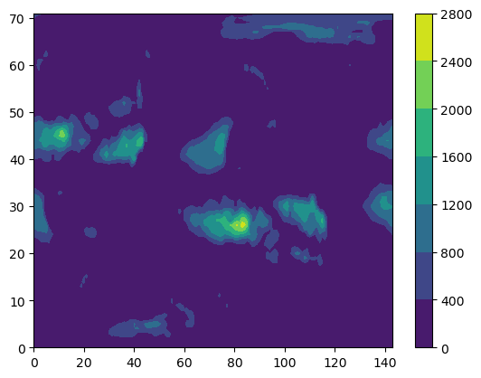
Stochastic Analysis:
Sad Plot 😔

Slide 18
Conclusion:
VARX Model can fit observational and reanalysis data fairly well. (May exclude extreme values/ smooths out spikes).
Using the VARX Model, we were able to apply the Maximized Log-likelihood to show that both datasets are generated by different statistical processes.
May be a good candidate for quickly comparing the statistic of two different datasets.

Slide 19


